Slide 2
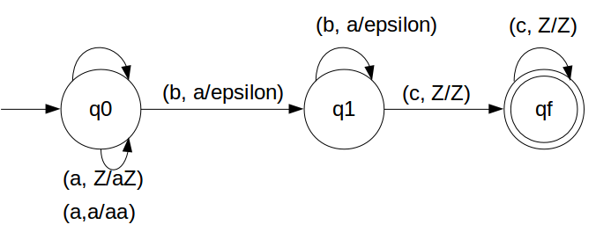
Construct a PDA for

Slide 3
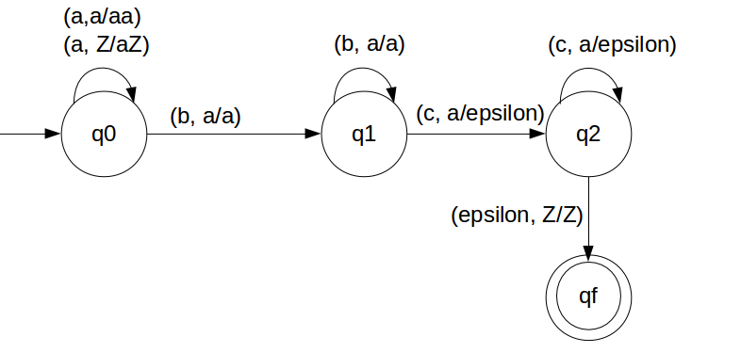
Construct a PDA for

Slide 4
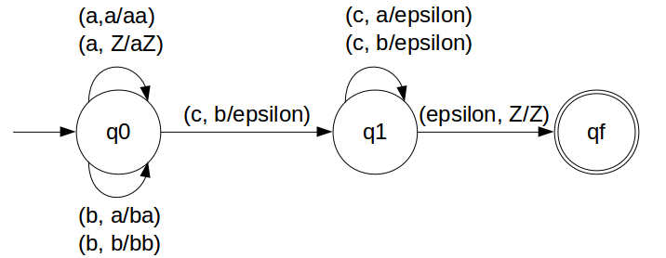
Construct a PDA for

Slide 5
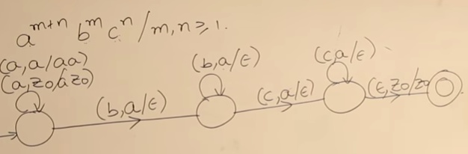
Construct a PDA for

Slide 6
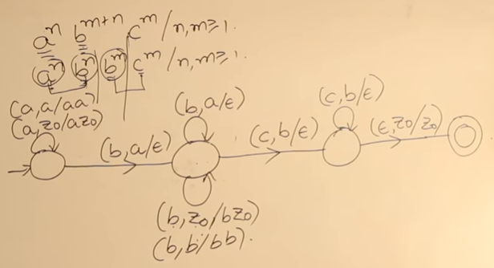
Construct a PDA for

Slide 7
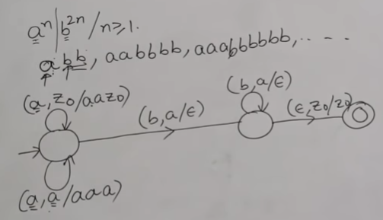
Construct a PDA for

